Slide 1
TV channel Russia 1

Slide 2
History TV channel begins in 1956 year.
1 January 1982 channel status Union cultural and educational, artistic, athletic programs central Television.
Significant place occupied : information, popular-science , musical , artistic, documentary and children's transmitting.

Slide 3
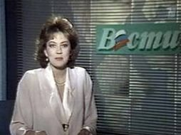
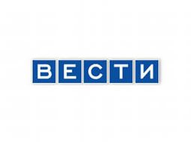
VESTI
13 may 1991 In 17-00 one ether program VESTI, leading was Svetlana Sorokina.
With 30 December 1991 program «VESTI» became get off three times in day, and with 20 January 1992 four times in day.

Slide 4
logotype
1 logotype RTV (13 May- 15 September 1991)

Slide 5
logotype
2 logotype RTR (16 September- 31 December 1991)

Slide 6
logotype
3 logotype RTR (1 January 1992 - 31 October 1993)

Slide 7
logotype
4 logotype RTR (1 November 1993 – 7 September 1998)

Slide 8
logotype
5 logotype RTR (8 September 1998- 14 September 2001 )

Slide 9
logotype
6 logotype RTR (15 September 2001- 31 August 2002 )

Slide 10
logotype
7 logotype Russia (1 September 2002- 23 December 2008 )

Slide 11
logotype
8 logotype Russia (24 December 2008- 31 December 2009 )

Slide 12
logotype
9 logotype Russia-1 (1 January 2010- 1 October 2012 )

Slide 13
logotype
10 logotype Russia-1 (1 October 2012- in presents time )

